Slide 1
Operator Overloading
CS 201, Summer 2013

Slide 2
ADDITIONAL READING
Operator Overloading
  Chapter 8 of Pearson textbook
  http://www.learncpp.com/cpp-tutorial/91-introduction-to-operator-overloading/
  http://www.cplusplus.com/doc/tutorial/classes2/

Slide 3
Operator Overloading
Operator Overloading would be used within a class, to specify how your custom object handles math (+, -, *, /), streaming (<<, >>), subscripts( [ ] ) and other things.

Slide 4
Operator Overloading
Why overload these operators?
  Writing a custom class and adding the functionality.
  Example: A fraction class with a numerator/denominator
    Would implement addition, subtraction, multiplication, and division
  Example: Your own list class
    Want to overload subscript [ ] operators to get a specific element.

Slide 5
Overloading Arithmetic
Declaration
In MyClass.h
class MyClass
{
public:
friend MyClass operator+( const MyClass& item1, const MyClass& item2 );
friend MyClass operator-( const MyClass& item1, const MyClass& item2 );
friend MyClass operator*( const MyClass& item1, const MyClass& item2 );
friend MyClass operator/( const MyClass& item1, const MyClass& item2 );
};
Implementation
In MyClass.cpp
MyClass operator+( const MyClass& item1, const MyClass& item2 )
{
// ...
}
Notice how this function definition is not part of MyClass. It is just a normal function.

Slide 6
Overloading Comparison
Declaration
In MyClass.h
class MyClass
{
public:
friend bool operator==( MyClass& item1, MyClass& item2 );
friend bool operator!=( MyClass& item1, MyClass& item2 );
friend bool operator<( MyClass& item1, MyClass& item2 );
friend bool operator>( MyClass& item1, MyClass& item2 );
friend bool operator<=( MyClass& item1, MyClass& item2 );
friend bool operator>=( MyClass& item1, MyClass& item2 );
};
Implementation
In MyClass.cpp
bool operator==( MyClass& item1, MyClass& item2 )
{
// ...
}

Slide 7
Overloading Streams
Declaration
In MyClass.h
#include <fstream>
class MyClass
{
public:
Friend ostream& operator<<( ostream& out, MyClass& item );
Friend istream& operator>>( istream& in, MyClass& item );
};
Implementation
In MyClass.cpp
ostream& operator<<( ostream& out, MyClass& item );
{
out << item.textField << endl;
return out;
}
istream& operator<<( istream& out, MyClass& item );
{
in >> item.loadedField;
}

Slide 8
Overloading Subscript
Declaration
In MyClass.h
class MyClass
{
public:
int& operator[]( const int index );
private:
int m_data[];
};
Note:
For Arithmetic, Stream, and Comparison, they did not belong to the MyClass class and were only friends of the MyClass class.
Here, the operator[ ] is part of MyClass.
Implementation
In MyClass.cpp
int& MyClass::operator[]( const int index );
{
return m_data[ index ];
}
Secondly:
The operator[ ] does not need to return an int, it will return whatever data-type you're wanting to access.

Slide 9
Overloading Assignment
Declaration
In MyClass.h
class MyClass
{
public:
MyClass& operator=( const MyClass& rhs );
private:
int variable1;
float variable2;
};
Note:
“rhs” stands for
“Right-Hand Side”
Implementation
In MyClass.cpp
MyClass& MyClass::operator=( const MyClass& rhs );
{
if ( this == &rhs )
return *this;
variable1 = rhs.variable1;
variable2 = rhs.variable2;
return *this;
}
MUST check for self-assignment!
There will be problems if the user tries to set an object to itself (without this check!)

Slide 10
Others...
You can also overload operators like:
  ++, --,
  +=, -=, *=, /=
  Binary operators
    +, -, * (
You can see examples of these at:
  http://courses.cms.caltech.edu/cs11/material/cpp/donnie/cpp-ops.html

Slide 11
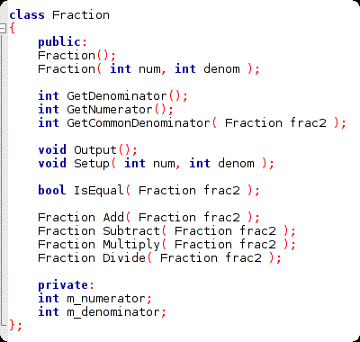
Let's Make Fractions!
We can make a fraction class that works without operator overloading.
This code is in the “08 Friends and Operator Overloading” Sample Code folder
https://github.com/Moosader/Problem-Solving-and-Programming-II

Slide 12
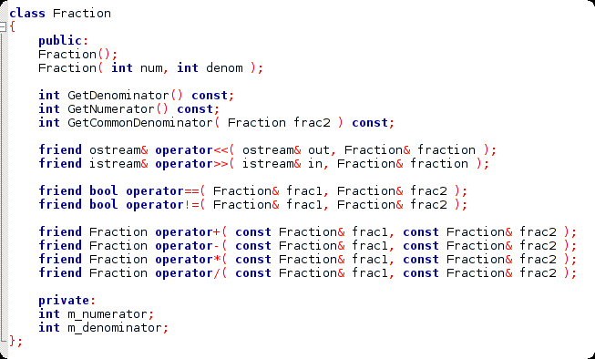
Let's Make Fractions!
Or we can utilize Operator Overloading

Slide 13
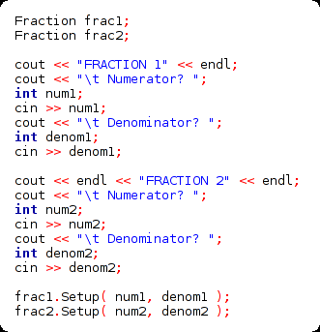
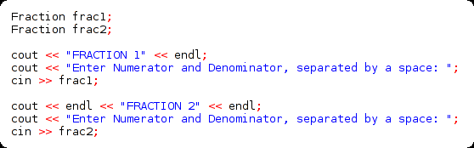
Let's Make Fractions!
Initializing the fractions
with Operator Overloading
We can overload the input stream operator so that it takes the numerator and denominator at the same time, and stores it directly in the fraction!
Initializing the fractions
without Operator Overloading

Slide 14
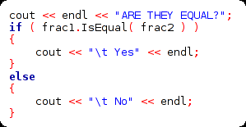
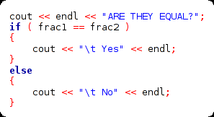
Let's Make Fractions!
Checking if equal
without Operator Overloading
Checking if equal
with Operator Overloading
Checking if the fractions are equal isn't any shorter if we overload the == operator
...But, using == is more consistent.
We compare ints and floats with ==,
so why not fractions, too?

Slide 15


Let's Make Fractions!
Arithmetic
without Operator Overloading
Arithmetic
with Operator Overloading
Doesn't it look kind of awkward to write
frac1.Add( frac2 ) ?

Slide 16
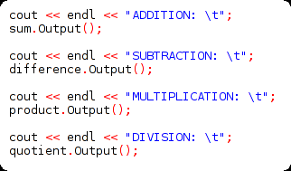
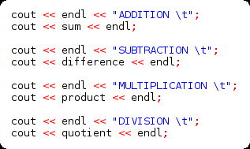
Let's Make Fractions!
Output
without Operator Overloading
Output
with Operator Overloading

Slide 17
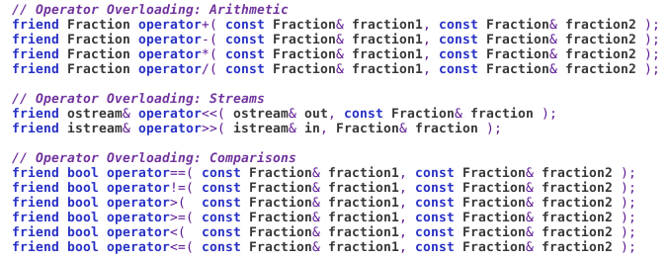
Operator Overloading with Fractions
Fractions are kind of perfect when it comes to Operator Overloading.
Make sure to check out the sample code for reference on how to use Operator Overloading!

Slide 18
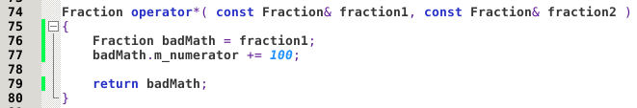
Criticism of Operator Overloading
Because we can define anything within our overloaded +, -, <<, >> (etc.) functions, some people argue that Operator Overloading is bad.
Maybe the usage of “+” in someone's class makes sense to them, but no sense to anyone else! (Some programmers are crazy)

Slide 19

Criticism of Operator Overloading
Other languages may handle Operator Overloading differently. For example, in Python, the function corresponding to Multiplication is “__mul__”:

Slide 20
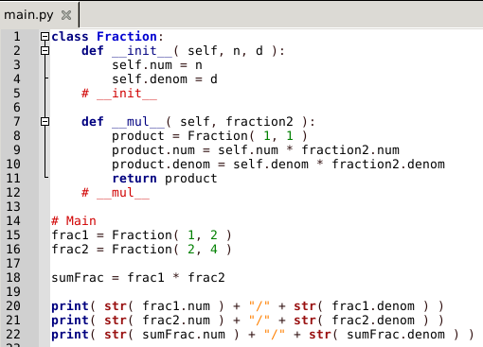
Criticism of Operator Overloading
Rather than overloading a function called “operator*”, we define a function “__mul__”. Then, we can use the multiplication operator * and Python will turn that into a call to “__mul__( fraction2 )”.

Slide 21
Review
Work with a group and turn in on a sheet of paper
Write a small class “Decimal” that contains two private integers: integer and decimal. Both are integers but decimal keeps track of how large the remainder/decimal side is.
Write a function called that overloads the + operator.
Add takes two “Decimal” numbers. “Add” is also a friend of the “Decimal” class.
Have the Add function add the decimal numbers appropriately and return the value (as another Decimal).
e.g., 1.88 + 2.04 = 3.92,
where 1, 2, and 3 are “integer” members
and 88, 04, and 91 are “decimal” members.

